Slide 1
Chapter 10

Slide 2

Topics
Binary Search Trees
Search, update, and implementation
AVL Trees
Properties and maintenance
Splay Trees
Properties and maintenance
2-4 Trees
Properties and maintenance
Red-black Trees
Properties and equivalence to 2-4 Trees

Slide 3
Binary Search Trees
<
6
2
>
9
1
4
=
8

Slide 4
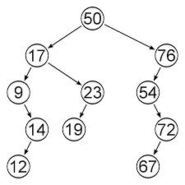
Binary Search Trees
Excellent data structure for storing the entries of a map or a dictionary

Slide 5
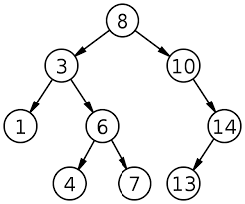
Binary Search Trees
A binary search tree is a binary tree storing keys (or key-value entries) at its internal nodes and satisfying the following property:
Let u, v, and w be three nodes such that u is in the left subtree of v and w is in the right subtree of v. We have key(u) ≤ key(v) ≤ key(w)
External nodes do not store items

Slide 6
Binary Search Trees
An in-order traversal of a binary search trees visits the keys in increasing order
6
2
9
1
4
8

Slide 7
Binary Search Trees (BST)
(20,Z)
All the keys in the green region are ≥ 20
Note that two keys of equal value may be well-separated
(10,A)
(35,R)
BST Rules:
Entries stored only at internal nodes
Keys stored at nodes in the left sub-tree of v are less than or equal to the key stored at v
Keys stored at nodes in the right sub-tree of v are greater than or equal to the key stored at v
An inorder traversal will return the keys in order
(7,T)
(14,J)
(21,O)
(37,P)
(1,Q)
(8,N)
(36,L)
(40,X)
(1,C)
(5,H)
(7,P)
(10,U)
(2,R)
(5,G)
(5,I)
(6,Y)
All the keys in the black region are ≤ 20

Slide 8
Searching
To search for a key k in a map or dictionary, one traces a downward path starting at the root (decision tree)
The next node visited depends on the outcome of the comparison of k with the key of the current node
If we reach a leaf, the key is not found and we return null
Example: find(4):
Call TreeSearch(4,root)
<
6
2
>
9
1
4
=
8

Slide 9
Analysis of Binary Tree Searching
TreeSearch is recursive algorithm
TreeSearch is called on the nodes of a path that starts at the root and goes down one level at a time
The number of nodes is bounded by h+1
Algorithm runs in in O(h) time (height of the tree) – worst case
Algorithm TreeSearch(k, v)
if T.isExternal (v)
return v
if k < key(v)
return TreeSearch(k, T.left(v))
else if k > key(v) then
return TreeSearch(k, T.right(v))
return v {k = key(v)}

Slide 10

Insertion
insertAtExternal (v,e)
Insert the element e at the external node v and expand v to be internal, having new (empty) external node children; an error occurs if v is an internal node

Slide 11
Insertion Algorithm
Algorithm TreeInsert(k,x,v)
Input: A new search key, an associated value x and a node v of T
Output: A new node w in the subtree T(v) that stores entry (k,x)
W←TreeSearch(k,v)
If T.isinternal(w) then
return TreeInsert(k, x,T.left(v)) T.insertAtExternal(w,(k,x))
return w

Slide 12
Insertion Example
insert 5
6
<
2
>
9
1
4
>
8
w
6
2
9
1
4
8
w
5

Slide 13
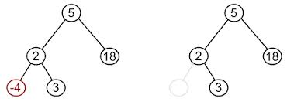
Removal
One needs to avoid creating “holes” in the binary search tree

Slide 14

Removal (Case 1)
If one of the children of a node w is an external node, say z, one simply removes w and z
Remove an external node v and its parent, replacing v’s parent with v’s sibling (an error occurs if v is not external)

Slide 15
Removal Example 1
remove 4
<
6
2
>
9
1
4
v
8
w
5
6
2
9
1
5
8

Slide 16

Removal (Case 2) (1)
If both children of node w are internal nodes
One cannot remove w since it would create a hole
One finds the internal node y that follows w in an in-order traversal (node y is the left most internal node in the right subtree of w)
(If the right sub-tree does not have a left most node then replace w with the right most node of the left sub-tree)

Slide 17

Removal (Case 2) (2)
The left child x of y is the external node that immediately follows node w in the in-order traversal
One moves y into w
One removes nodes y and its left child x (which must be a leaf)

Slide 18
Removal Example 2
1
w
remove 3
3
2
8
6
9
y
5
x
1
v
5
2
8
6
9

Slide 19

Performance of a Binary Search Tree (1)
Consider a map or dictionary with n items (key-values) implemented by means of a binary search tree of height h
The space used is O(n)
Methods size and empty each take O(1) time
Methods find, insert and erase take O(h) time
Running time of the search and update methods vary dramatically depending on the height of the tree

Slide 20
Performance of a Binary Search Tree (2)
The height h is n in the worst case and log n in the best case
Let h be the height of a dictionary storing n keys
Since there are 2i keys at depth i = 0, … , h (1) and at least one key at depth h, we have n ≥ 1 + 2 + 4 + … + 2h-1 + 1 =2h-1+1 (geometric sum) = 2h
Taking the log of both sides of n ≥ 2h => h ≤ log n
A binary search tree is an efficient implementation of a dictionary only if the height is small
Worse case – no better than a list or array implementation
Best case

Slide 21
C++ Implementation of a Binary Search Tree (1)
template <typename E>
class SearchTree { // a binary search tree
public: // public types
typedef typename E::Key K; // a key
typedef typename E::Value V; // a value
class Iterator; // an iterator/position
public: // public functions
SearchTree(); // constructor
int size() const; // number of entries
bool empty() const; // is the tree empty?
Iterator find(const K& k); // find entry with key k
Iterator insert(const K& k, const V& x); // insert (k,x)
void erase(const K& k) throw(NonexistentElement); // remove key k entry
void erase(const Iterator& p); // remove entry at p
Iterator begin(); // iterator to first entry
Iterator end(); // iterator to end entry
10.3

Slide 22
C++ Implementation of a Binary Search Tree (2)
protected: // local utilities
typedef BinaryTree<E> BinaryTree; // linked binary tree
typedef typename BinaryTree::Position TPos; // position in the tree
TPos root() const; // get virtual root
TPos finder(const K& k, const TPos& v); // find utility
TPos inserter(const K& k, const V& x); // insert utility
TPos eraser(TPos& v); // erase utility
TPos restructure(const TPos& v) // restructure
throw(BoundaryViolation);
private: // member data
BinaryTree T; // the binary tree
int n; // number of entries
public:
// ...insert Iterator class declaration here
};
10.4

Slide 23
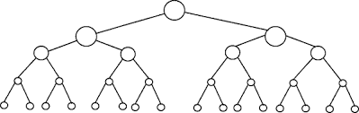
Malik’s C++ Implementation of a Binary Search Tree
See chapter 10 example

Slide 24
AVL (Georgy Adelson-Velsky and Evgenii Landis) Trees
6
v
3
8
z
4

Slide 25
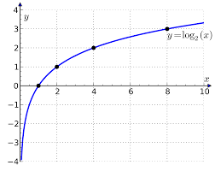
Definition of an AVL Tree
Goal: Achieve logarithmic time for all fundamental map and dictionary operations
Add a rule to the binary search tree definition called the height-balance property
Characterizes the structure of a binary tree in terms of the heights of its internal nodes
The height of a node v is the length of the longest path from v to an external node

Slide 26
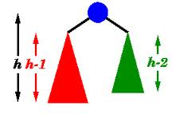
Height-Balance Property
For every internal node v of T, the heights of the children of v can differ by at most 1

Slide 27
AVL Tree Definition
A binary search tree that satisfies the height-balance property is said to be an AVL tree (keeps the height small) - Balanced
An example of an AVL tree where the heights are shown next to the nodes

Slide 28

Tree Terminology
Height of a tree: maximum depth of any node
Internal node: node with at least one child
2
6
1
1
3
8

Slide 29
Height of an AVL Tree
Proposition 10.2: The height of an AVL tree storing n keys is O(log n)

Slide 30
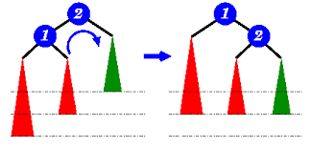
Insertion in an AVL Tree
Insertion starts like it does as in a binary search tree
insertAtExternal() - inserts a entry at node w that was previously an external node and w becomes an internal node
Adds two external node children to w
Height-balance rule may be violated
The tree may be have to be restructured

Slide 31
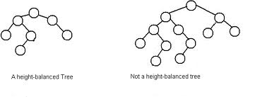
Balanced Nodes
An internal node v is balanced if the absolute value of the difference between the heights of the children of v is at most 1, otherwise it is unbalanced
Every internal node of an AVL tree must be balanced

Slide 32
Insertion in an AVL Tree
Insert 54 (before restructuring)
44
44
17
78
17
78
c=z
a=y
32
50
88
32
50
88
48
62
48
62
b=x
54
w
before insertion
after insertion
Nodes 44 and 78 are unbalanced

Slide 33
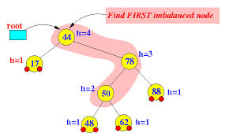
Starting the Trinode Restructuring
Let z be the first node encountered going up from w toward the root that is unbalanced
Let y be the child of z with the greater height
y is an ancestor of w
Let x be the child of y with the greater height
x is an ancestor of w
x is a grandchild of z and could be w

Slide 34

restructure(x) (1)
Input: A node, x, of a search binary tree that has both a parent, y, and a grandparent, z
Output: Tree T after a trinode restructuring (single or double rotation)
Let (a, b, c) be a left to right (inorder) listing of nodes x, y, and z and let (T₀, T₁, T₂, T₃) be the left to right listing (inorder) of the four sub-trees of x, y, and z not rooted at x, y, or z

Slide 35

restructure(x) (2)
Replace the sub-tree rooted at z with a new sub-tree rooted at b
Let a be the left child of b and let T₀ and T₁ be the left and right sub-trees of a, respectfully
Let c be the right child of b and let T₂ and T₃ be the left and right sub-trees of c, respectfully

Slide 36
Restructuring: Single Rotations
Single rotations:
a = z
single rotation
b = y
b = y
a = z
c = x
c = x
T
0
T
3
T
1
T
3
T
0
T
1
T
2
T
2
single rotation
c = z
b = y
b = y
a = x
c = z
a = x
T
3
T
0
T
0
T
2
T
1
T
2
T
3
T
1

Slide 37
Restructuring: Double Rotations
Double rotations:
a = z
double rotation
b = x
c = y
a = z
c = y
b = x
T
0
T
2
T
T
3
T
0
T
1
T
3
2
T
1
c = z
double rotation
b = x
a = y
a = y
c = z
b = x
T
3
T
1
T
0
T
1
T
0
T
2
T
3
T
2

Slide 38
Insertion Example
44
z=c
17
y= a
78
Insert 54
32
50
x=b
88
Nodes 44 and 78 are unbalanced
48
62
54
T
3
T
T
T
2
0
1
T
1
44
b
unbalanced...
17
a
62
c
32
50
78
48
54
88
...balanced
T
2
T
T
T
3
0
1

Slide 39
Another Insertion Example
Insert 49 (before restructured)
44
44
17
78
17
78
c=z
b=y
32
50
88
T₃
32
50
88
48
62
48
62
a=x
T₀
49
T₂
w
before insertion
T₁
after insertion
Nodes 44 and 78 are unbalanced

Slide 40
Insertion in an AVL Tree
Insert 49 (after restructuring)
44
b=y
17
50
a=x
c=z
32
48
78
62
88
49
w
After insertion

Slide 41

Removal in an AVL Tree
Removal of a node begins as in a binary search tree using the removeAboveExternal() method
Elevates one of its children into its place
The operation may cause the height-balance property to be violated

Slide 42
Example of Removing a Node from an AVL Tree
44
44
17
62
17
62
W
32
50
78
50
78
48
54
88
48
54
88
Before deletion of 32
After deletion
Before restructuring

Slide 43

Rebalancing after Removal (1)
Let z be the first unbalanced node encountered while travelling up the tree from w (node removed)
Let y be the child of z with the greater height
y is not an ancestor of z
Let x be the child of y with the greater height or
If both children have the same height then let x be the child of y on the same side as y (e.g. if y is a left child then x is a left child)

Slide 44

Rebalancing after Removal (2)
One performs a restructure(x) to restore balance at z
As this restructuring may upset the balance of another node higher in the tree
One must continue checking for balance until the root of T is reached

Slide 45
Rebalancing after Removal
a=z
62
44
44
78
17
62
b=y
17
50
88
50
78
c=x
T₀
48
54
48
54
88
T₀
T₃
T₁
T₂
T₁
T₃
T₂

Slide 46

Running Times for AVL Trees
size() and empty() is O(1)
find() is O(log n)
height of tree is O(log n), no restructures needed
insert() is O(log n)
initial find is O(log n)
Restructuring up the tree, maintaining heights is O(log n)
erase() is O(log n)
initial find is O(log n)
Restructuring up the tree, maintaining heights is O(log n)

Slide 47
C++ Implementation of a AVLEntry
template <typename E>
class AVLEntry : public E { // an AVL entry
private:
int ht; // node height
protected: // local types
typedef typename E::Key K; // key type
typedef typename E::Value V; // value type
int height() const { return ht; } // get height
void setHeight(int h) { ht = h; } // set height
public: // public functions
AVLEntry(const K& k = K(), const V& v = V()) // constructor
: E(k,v), ht(0) { }
friend class AVLTree<E>; // allow AVLTree access
};
10.13

Slide 48
C++ Implementation of a AVL Tree (1)
template <typename E> // an AVL tree
class AVLTree : public SearchTree< AVLEntry<E> > {
public: // public types
typedef AVLEntry<E> AVLEntry; // an entry
typedef typename SearchTree<AVLEntry>::Iterator Iterator; // an iterator
protected: // local types
typedef typename AVLEntry::Key K; // a key
typedef typename AVLEntry::Value V; // a value
typedef SearchTree<AVLEntry> ST; // a search tree
typedef typename ST::TPos TPos; // a tree position
public: // public functions
AVLTree(); // constructor
Iterator insert(const K& k, const V& x); // insert (k,x)
void erase(const K& k) throw(NonexistentElement); // remove key k entry
void erase(const Iterator& p); // remove entry at p
10.14

Slide 49
C++ Implementation of a AVL Tree (2)
protected: // utility functions
int height(const TPos& v) const; // node height utility
void setHeight(TPos v); // set height utility
bool isBalanced(const TPos& v) const; // is v balanced?
TPos tallGrandchild(const TPos& v) const; // get tallest grandchild
void rebalance(const TPos& v); // rebalance utility
};
10.14

Slide 50
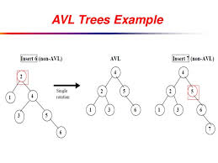
AVL Tree Implementation
See AVL example

Slide 51

Splay Trees
6
v
3
8
z
4

Slide 52

Splay Trees (1)
Are binary search trees
Another way to implement a map or a dictionary
Does not use any explicit rules to enforce balance (like AVL trees)

Slide 53
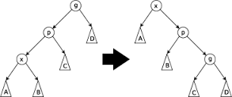
Splay Trees (2)
Applies a certain move-to-root operation (called splaying) after every access in order to keep the search tree balanced in an amortized sense
Performed at the bottom most node reached during an insert, deletion, or a search
Guarantees logarithm running times

Slide 54
Searching in a Splay Tree (1)
(20,Z)
Same as in a BST
Search proceeds down the tree to found item or an external node
Example: Search for time with key 11
(10,A)
(35,R)
(7,T)
(14,J)
(21,O)
(37,P)
(1,Q)
(8,N)
(36,L)
(40,X)
(1,C)
(5,H)
(7,P)
(10,U)
(2,R)
(5,G)
(5,I)
(6,Y)

Slide 55
Searching in a Splay Tree (2)
(20,Z)
Search for key 8, ends at an internal node
(10,A)
(35,R)
(7,T)
(14,J)
(21,O)
(37,P)
(1,Q)
(8,N)
(36,L)
(40,X)
(1,C)
(5,H)
(7,P)
(10,U)
(2,R)
(5,G)
(5,I)
(6,Y)

Slide 56
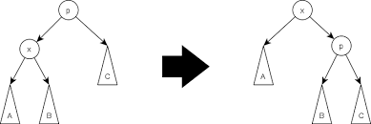
Splaying
One “splays” x by moving x to the root of a tree, T through a series of restructurings
Operation depends upon the relative positions of x, it parent y, and (if it exists) x’s grandparent z

Slide 57
zig-zig (Right Children)
The node x and its parent y are both right children
One replaces z by x, making y a left child of x and z a left child of y while maintaining the inorder relationship
Z=10
a
T₁
Y=20
b
T₂
X=30
c
X=30
c
T₃
T₄
T₄
Y=20
b
Z=10
a
T₃
T₁
T₂

Slide 58
zig-zig (Left Children)
c
Z=30
b
Y=20
T₄
X=10
a
a
X=10
T₃
T₁
Y=20
b
T₁
T₂
T₂
Z=30
c
The node x and its parent y are both left children
One replaces z by x, making y a right child of x and z a right child of y while maintaining the in-order relationship
T₃
T₄

Slide 59
zig-zag
One of x and y is a left child and the other is a right child
One replaces z by x, making x have y and z as its children while maintaining the in-order relationship
a
b
Z=10
X=20
c
a
Y=30
Z=10
c
Y=30
T₁
X=20
b
T₄
T₁
T₂
T₃
T₄
T₂
T₃

Slide 60
Another zig-zag
c
b
Z=30
X=20
T₄
y=10
a
z=30
c
Y=10
a
T₁
T₂
T₃
T₄
T₁
X=20
b
T₂
T₃

Slide 61
zig
x does not have a grandparent (or we are not considering x’s grandparent for some reason)
One rotates x over y, making x’s children be the node y and one of x’s former children w while maintaining the inorder relationship
y=10
a
b
T₁
x=20
c
b
T₂
w=30
X=20
c
T₃
T₄
a
Y=10
W=30
T₁
T₂
T₃
T₄

Slide 62
Another zig
c
Y=30
b
b
X=20
T₄
X=20
a
W=10
T₃
a
W=10
Y=30
c
T₁
T₂
T₃
T₄
T₁
T₂

Slide 63
Splaying:
“x is a left-left grandchild” means x is a left child of its parent, which is itself a left child of its parent
p is x’s parent; g is p’s parent
start with node x
is x a left-left grandchild?
is x the root?
yes
zig-zig
stop
yes
right-rotate about g, right-rotate about p
no
is x a right-right grandchild?
is x a child of the root?
zig-zig
no
yes
left-rotate about g, left-rotate about p
yes
is x a right-left grandchild?
is x the left child of the root?
zig-zag
no
yes
left-rotate about p, right-rotate about g
is x a left-right grandchild?
zig
zig
zig-zag
yes
right-rotate about the root
left-rotate about the root
yes
right-rotate about p, left-rotate about g

Slide 64
Summary of Splays
One performs a zig-zig or a zig-zag when x has a grandparent
One performs a zig when x does not have a grandparent
A splaying step consists of repeating the above restructurings at x until x becomes the root of the tree

Slide 65
Splaying Example (1)
8
3
10
4
11
6
12
5
7
y
15
z
13
Splaying node 14
Beginning of a zig-zag
x
17
14
T₁
T₄
T₂
T₃

Slide 66
Splaying Example (2)
8
10
3
4
11
6
7
12
5
x
14
zig-zag complete
13
y
z
15
17
T₂
T₁
T₃
T₄

Slide 67
Splaying Example (3)
8
3
10
4
11
z
6
12
y
5
7
T₁
x
14
T₂
Beginning of a zig-zig
13
15
T₃
17
T₄

Slide 68
Splaying Example (4)
8
10
3
14
x
4
y
15
6
12
5
7
13
17
Z
11
T₄
T₃
zig-zig complete
T₁
T₂

Slide 69
Splaying Example (5)
Z
8
y
10
3
x
14
T₂
4
15
6
12
5
7
13
17
11
T₁
T₄
T₃
Beginning of a zig-zig

Slide 70
Splaying Example (6)
x
14
y
10
15
Z
12
8
13
17
3
11
4
T₂
T₄
6
T₃
5
7
zig-zig complete
T₁

Slide 71
What Node to Splay (When)
Which nodes are splayed after each operation?
method
splay node
if key found, use that node (search)
if key not found, use parent of ending external node
find(k)
insert(k,v)
use the new node containing the entry inserted
use the parent of the internal node that was actually removed from the tree (the parent of the node that the removed item was swapped with) (deletion)
erase(k)

Slide 72
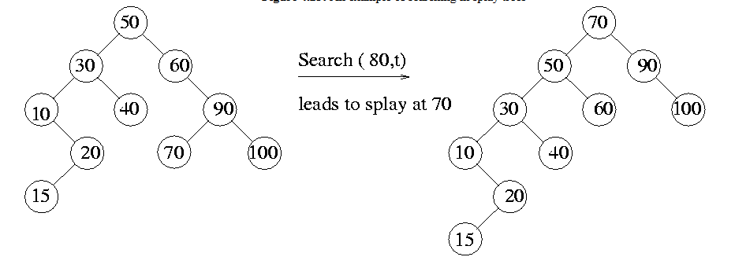
Splaying when Searching

Slide 73
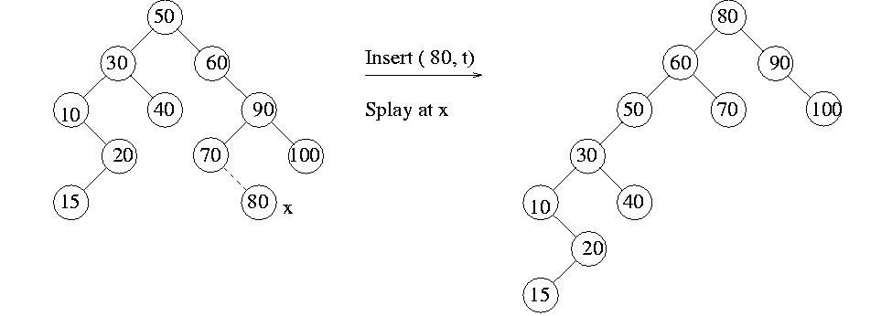
Splaying when Inserting

Slide 74
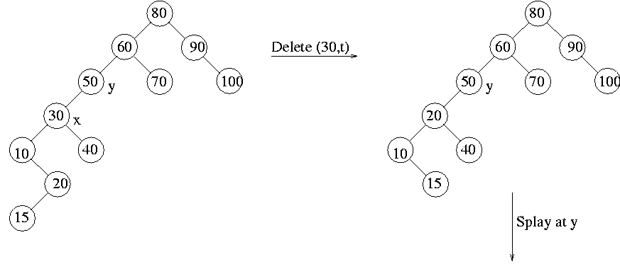
Splaying when Deleting (1)

Slide 75
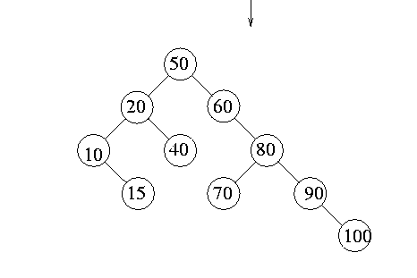
Splaying when Deleting (2)

Slide 76
Deleting the Root (1)
8
8
3
10
3
10
4
4
11
11
6
6
5
7
5
7
Note: In the book’s example, the right most node of the left subtree was used during the deletion
Initial tree
removing 8

Slide 77
Deleting the Root (2)
7
7
10
3
10
3
4
11
4
11
T₁
6
6
T₂
5
5
T₄
T₃
7 move to the root
beginning of splaying

Slide 78
Deleting the Root (3)
7
7
6
10
10
6
4
T₄
11
4
T₃
11
5
5
T₄
3
T₃
3
T₂
T₁
T₁
T₂
splaying complete
Begin another splaying

Slide 79
Deleting the Root (4)
6
7
4
T₃
10
3
5
11
T₁
T₂
T₄
splaying complete

Slide 80
Splay Tree
The overall running time of a search, insertion, or deletion is O(h), where h is height of the tree
The height of a tree could be as large as n

Slide 81
(2,4) Trees
9
2 5 7
10 14

Slide 82
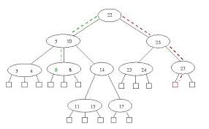
Multi-Way Search Tree (1)
Let v be a node of an ordered tree
v is called a d-node if v has d children
Multi-Way Search Tree
Each internal node has at least two children
Is a d-node where d is ≥ 2

Slide 83
Multi-Way Search Tree (2)
Each internal d-node with children v₁ v₂ … v_{d} stores an ordered set of d-1 key-value entries (k_{i} , x_{i})
where k₁ ≤ … ≤ k_{d-1}
d-nodes store d-1 regular keys
Define k₀= -
Define k_{d}=
For each entry (k,x) stored at a node in the subtree of v rooted at v_{i}, k_{i-1} ≤ k≤ k_{i}
Each key k, is stored between two other keys

Slide 84
Multi-Way Search Tree (3)
External nodes do not store any entries and serve as placeholders
An n-entry multi-way search tree has n+1 external nodes
A binary search tree is a multi-way search tree where each internal node and two children
11 24
2 6 8
15
27 32
30
4 external nodes => 4 node

Slide 85
Multi-Way Inorder Traversal
One can extend the notion of inorder traversal from binary trees to multi-way search trees
Namely, we visit item (k_{i}, o_{i}) of node v between the recursive traversals of the subtrees of v rooted at children v_{i} and v_{i} ₊ ₁
An inorder traversal of a multi-way search tree visits the keys in increasing order
11 24
8
12
2 6 8
15
27 32
2
4
6
10
14
18
30
1
3
5
7
9
11
13
16
19
15
17

Slide 86
Multi-Way Searching
Similar to search in a binary search tree
At each internal node with children v₁ v₂ … v_{d} and keys k₁ k₂ … k_{d−1}
k = k_{i} (i = 1, …, d (1)): the search terminates successfully
k < k₁: we continue the search in child v₁
k_{i−1} < k < k_{i} (i = 2, …, d (1)): we continue the search in child v_{i}
k > k_{d−1}: we continue the search in child v_{d}
Reaching an external node terminates the search unsuccessfully
Example: search for 30
11 24
2 6 8
15
27 32
30

Slide 87
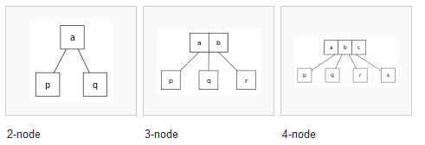
(2,4) Trees
A 2–4 tree (also called a 2–3–4 tree) is a self-balancing data structure that is commonly used to implement dictionaries
The numbers mean a tree where every node with children (internal node) has either two, three, or four child nodes
A 2-node has one data element, and has two child nodes;
A 3-node has two data elements, and has three child nodes;
A 4-node has three data elements, and has four child nodes

Slide 88
(2,4) Trees
A (2,4) is a multi-way search with the following properties
Node-Size Property: every internal node has at most four children (and at least two children)
Depth Property: all the external nodes have the same depth
Depending on the number of children, an internal node of a (2,4) tree is called a 2-node, 3-node or 4-node
10 15 24
2 8
12
18
27 32
External nodes are empty

Slide 89
Height of a (2,4) Tree
Theorem: A (2,4) tree storing n items has height O(log n)
Proof:
Let h be the height of a (2,4) tree with n items
Since there are at least 2^{i} items at depth i = 0, … , h (1) and no items at depth h, we have n ≥ 1 + 2 + 4 + … + 2^{h−1} = 2^{h} (1)
Thus, h ≤ log (n + 1)
Searching in a (2,4) tree with n items takes O(log n) time
depth
items
0
1
1
2
h−1
2^{h−1}
h
0

Slide 90
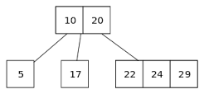
Insertion
To insert a new item (k, x) one first performs a search for key k
If the tree has no entry with key k, the search terminates at node z
Let v be the parent of z, one inserts the new entry into node v and adds a new child w (an external node) to v on the left of z
Entry (k,x,w) is added
The depth property is always preserved
The insert may cause an overflow
Node v may become a 5-node
This must be resolved

Slide 91
Insertion
Example: inserting key 30 causes an overflow
10 15 24
v
2 8
12
18
27 32 35
10 15 24
v
2 8
12
18
27 30 32 35

Slide 92
Overflow and Split
We handle an overflow at a 5-node v with a split operation:
Replace v with two nodes v’ and v’’
v’ is a 3-node with children v₁, v₂, an v₃ storing keys k₁ and k₂
v’’ is a 2-node with children v₄ an v₅ storing key k₄
If v was a root of a tree, create a new root u; else let u be the parent of v
Insert key k₃ into u and make v’ and v’’ children of u
If v was a child i of u, then v’ and v’’ become children i and i+1 respectfully
u
u
15 24
15 24 32
v
v'
v"
12
18
27 30 32 35
12
18
27 30
35
v₁
v₂
v₃
v₄
v₅
v₁
v₂
v₃
v₄
v₅

Slide 93
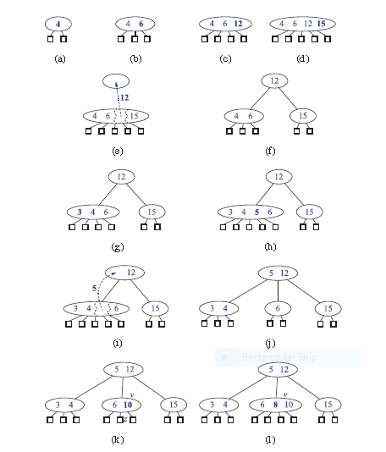
Insertion Example
Figure 10.23

Slide 94
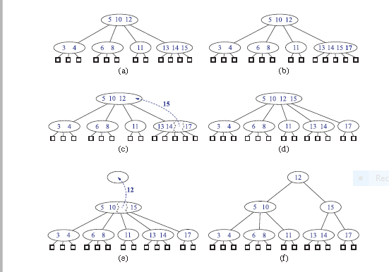
Insertion
Figure 10.25

Slide 95
Analysis of Insertion
Let T be a (2,4) tree with n items
Tree T has O(log n) height
Step 1 takes O(log n) time because we visit O(log n) nodes
Step 2 takes O(1) time
Step 3 takes O(log n) time because each split takes O(1) time and we perform O(log n) splits
Thus, an insertion in a (2,4) tree takes O(log n) time
Algorithm insert (k,x)
1. Search for key k to locate the insertion node v
2. Add the new entry (k,x) at node v
3. while overflow(v)
if isRoot(v)
create a new empty root above v
v ← split(v)

Slide 96

Removal (1)
Removing an entry can always be reduced to the case where the entry to be removed is stored at a node v whose children are external nodes
If the entry at node z has only internal children, one swaps the entry (k_{i},x_{i}) with the appropriate entry that is stored at a node v with external-node children as follows
One finds the right-most internal node v rooted at the i^{th} child of z, noting that the children of node v are all external nodes
One swaps the entry (k_{i},x_{i}) at z with the last entry of v

Slide 97

Removal (2)
Since the entry stored at node v to be removed has only external children, one simply removes the entry from v
Removing an entry (and a child) always preserves the depth property
The size property may become violated
If v was a 2-node, then it becomes a 1-node with one child and no keys (underflow)
To handle an underflow at node v with parent u, one considers two cases

Slide 98
Underflow and Transfer
Case 1: An adjacent sibling w of v is a 3-node or a 4-node
Transfer operation:
1. Move a child of w to v
2. Move a key of w to parent u of w and v
3. Move a key of u to v
After a transfer, no underflow occurs
u
u
4 9
4 8
w
v
w
v
2
6 8
12
2
6
9

Slide 99
Underflow and Fusion
Case 2: if v has only one sibling or the immediate siblings of v are 2-nodes
Fusion operation:
1. One merges v with a sibling creating a new node v’
2. Move a key from the parent u of v to v’
After a fusion, the underflow may propagate to the parent u
u
u
9 14
9
w
v
v'
2 5 7
10
12
2 5 7
10 14
Fusion occurs using the left sibling if both siblings are eligible for fusion

Slide 100
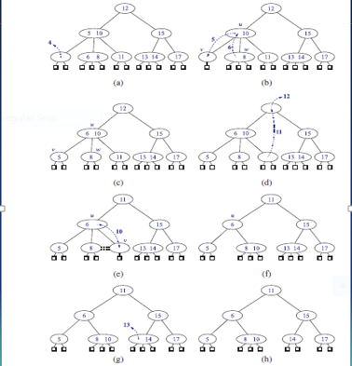
Removal Example
Removal of 4 causing an underflow
Transfer operation
After the transfer
(d) Removal of 12 causing an underflow
(e) Fusion operation
(f) After the fusion
(g) Removal of 13
(h) After removing 13
Right most internal child in the subtree at the ith (1st) child
Figure 10.25

Slide 101
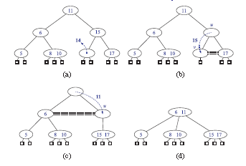
More Removal Examples
Removal of 14
causes an underflow
(b) Fusion which causes another underflow
(c) Second fusion operation which causes the root to be removed
Figure 10.26

Slide 102
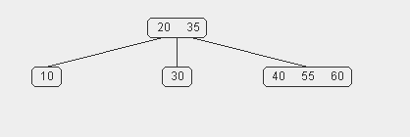
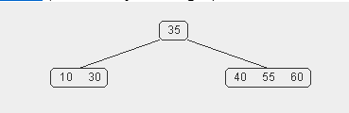
Removal from a 2-4 Tree with Internal Children
Remove node 20 from this 2-4 tree

Slide 103
Analysis of Removal
Let T be a (2,4) tree with n items
Tree T has O(log n) height
In a removal operation
One visits O(log n) nodes to locate the node from which to delete the entry
One handles an underflow with a series of O(log n) fusions, followed by at most one transfer
Each fusion and transfer takes O(1) time
Thus, removing an item from a (2,4) tree takes O(log n) time

Slide 104
Implementing a Dictionary
Comparison of efficient dictionary implementations
 | Search | Insert | Delete | Notes
Hash Table | 1 expected | 1 expected | 1 expected | no ordered dictionary methods simple to implement
Skip List | log n high prob. | log n high prob. | log n high prob. | randomized insertion simple to implement
(2,4) Tree | log n worst-case | log n worst-case | log n worst-case | complex to implement

Slide 105
Red-Black Trees
6
v
3
8
z
4

Slide 106
Red-Black Trees
A red-black tree is a binary search tree with nodes colored red and black such that
Root Property: the root is black
External Property: every external node is black
Internal Property: the children of a red node are black
Depth Property: all the external nodes have the same black depth
Defined as the number of black ancestors minus one
(node is an ancestor of itself)
9
4
15
2
6
12
21
All external nodes have three black ancestors in this example – their black depth is two
Edge is the same color as the child node
7

Slide 107

Conversion from (2,4) to Red-Black Trees (1)
Given a red-black tree, one can construct a corresponding (2,4) tree by merging every red node into its parent storing the entry from v at its parent
Red–black trees are simpler to implement than 2-4 trees so they tend to be used more

Slide 108

Conversion from Red-Black to (2,4) Trees (2)
Given a (2,4) tree, one can construct a corresponding red-black tree by coloring each node black and performing a transformation for each internal node v

Slide 109

Conversion from Red-Black to (2,4) Trees (3)
If v is a 2-node, then keep the (black) children of v as is
If v is a 3-node, then create a new red node w, give v’s first two (black) children to w and make w and v’s third child be the two children of v
If v is a 4-node, then create two new red nodes w and z, give v’s first two (black) children to w, give v’s last two (black) children to z, and make w and z be the two children of v

Slide 110
Converting Trees
Converting between (2,4) trees and Red-Black trees
4
3 5
2 6 7
4
5
3
6
OR
3
5
2
7

Slide 111
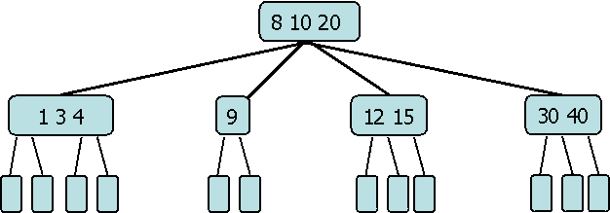
2-4 to Red-Black Conversion Example
10
8
20
9
12
40
3
1
4
15
30

Slide 112

Height of a Red-Black Tree
Theorem: A red-black tree T, storing n entries has height O(log n)
Proof:
Let d be the common black depth of all external nodes
Let T’ be the (2,4) tree and h’ be the height of T’
Because of the relationship between red-black and (2,4) trees, h’=d
Since the height of a (2,4) is O(log n), d=h’ ≤ log(n+1)
The height of a red-black tree is at most twice the height of its associated (2,4) tree, which is O(log n) hence h ≤ 2d, thus h ≤ 2log(n+1)
log(n+1) ≤ h by proposition 7.10 and the fact that T has n internal nodes

Slide 113
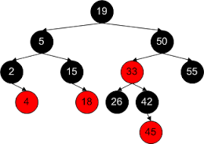
Red-Black Trees Update Operations

Slide 114
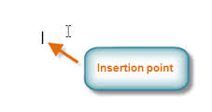
Insertion (1)
To perform operation insert(k,x)
One searches for key k in the tree until an external node is reached
The external node is replaced with an internal node z storing (k,x) having two external node children
If z is the root, one colors z black, else one colors z red
One colors the children of z black

Slide 115
Insertion (2)
The insertion preserves the root, external, and depth properties
If the parent v of z is black, the internal property is preserved and process is complete
If the parent v of z is red, one has a double red
A violation of the internal property which requires a reorganization of the tree

Slide 116
Insertion Causing a Double Red
Example:
Inserting 4 causes a double red
6
w
6
v
v
w
3
8
3
8
z
z
4

Slide 117
Remedying a Double Red (Case 1)
If the sibling w of v is black (perform a trinode restructuring)
u=a
u=a
u=c
u=c
w
2
v=c
v=a
6
w
6
w
w
2
v=b
1
6
2
8
v=b
4
8
4
1
4
4
z=a
2
6
z=c
z=b
z=b
b
4
After the restructure, one colors b black and a and c red
z is the new node
v is the parent of z
u is the parent of v
w is the sibling of v
a, b, c is in-order
c
a
2
6

Slide 118
Remedying a Double Red (Case 2)
If the sibling w of v is red, the double red corresponds to an overflow
Perform a Recoloring (see next slide)
Equivalent of a 2-4 tree split
4
v
2 4 6 7
w
7
2
z
6
z is the new node
v is the parent of z
u is the parent of v
w is the sibling of v

Slide 119
Recoloring
A recoloring remedies a child-parent double red when the parent red node has a red sibling
The parent v and its sibling w become black and the grandparent u becomes red, unless it is the root
It is equivalent to performing a split on a 5-node
The double red violation may propagate to the grandparent u (one may have to perform another recoloring)
w
4
v
w
4
v
2
z
7
2
z
7
6
6
… 4 …
2 4 6 7
2
6 7

Slide 120
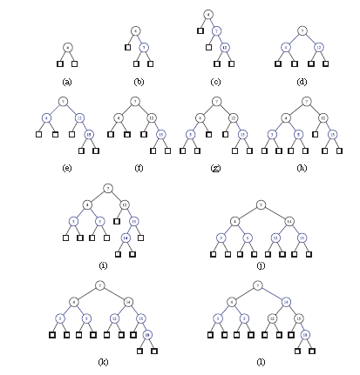
Red-Black Insertion Example (1)
Insert 4, 7, 12, 15, 3, 5, 14, 18
Figure 10.31

Slide 121
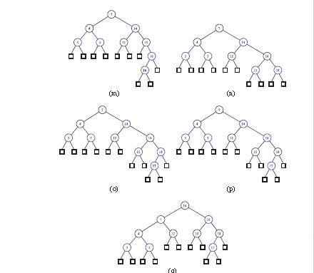
Red-Black Insertion Example (2)
Insert 16, 17
Figure 10.32

Slide 122
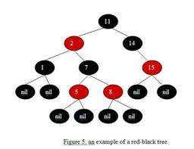
Pseudo Code for an of Insertion
Algorithm insert(k,x)
1. We search for key k to locate the insertion node z
2. We add the new entry (k,x) at node z and color z red
3. while doubleRed(z)
if isBlack(sibling(parent(z)))
z ← restructure(z)
return
else { sibling(parent(z) is red }
z ← recolor(z)

Slide 123
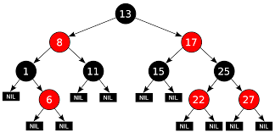
Analysis of an Insertion
Recall that a red-black tree has O(log n) height
Step 1 takes O(log n) time because we visit O(log n) nodes
Step 2 takes O(1) time
Step 3 takes O(log n) time because we perform
O(log n) recolorings, each taking O(1) time, and at most one restructuring taking O(1) time
Thus, an insertion in a red-black tree takes O(log n) time

Slide 124
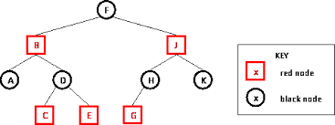
Removals at Nodes with External Children
To perform operation remove(k), one executes the remove algorithm for binary search trees
One searches for a node u storing the entry
If u does not have an external child one finds the internal node v following u in the in-order traversal
Move the entry at v to u (swap values – not colors)
Perform the removal at v
Thus one needs to consider only the removal of an entry with key k stored at a node v with an external child

Slide 125
Removal (1)
To remove the entry with key k from node v with external child w
Let r be the sibling of w and x be the parent of v
One removes nodes v and w
One makes r a child of x
x
6
v
8
r
w
w is an external child of v
r is the sibling of w and child of v
x is the parent of v
After removing v, r becomes a child of x
7
k
red or black

Slide 126

Removal (2)
If v is red (r must be black) or r is red (v must be black) - no double reds
One colors r black and the process is complete
x
6
v
8
w is an external child of v
r is the sibling of w and child of v
x is the parent of v
After removing v, r becomes a child of x
r
w
7
k
red or black

Slide 127

Removal (3)
If r is black and v is black, one gives r a “fictitious” double black color to preserve the depth property
A color violation occurs (called the double black problem)
Equivalent to an underflow in the corresponding (2,4) tree

Slide 128
Double Black Problem
Deletion of 8 causes a double black violation
x
x
y
6
v
y
6
r
3
8
3
r
w
4
4
double black signifying a depth problem

Slide 129

Remedying a Double Black (Case 1) – 1
The sibling y of r is black and has a red child
Let the red child be z
If both children of y are red then if y is a right child of x, let z be the right child of y otherwise let z be the left child of y
y is the sibling of r
x is the parent of r
z is a red child of y

Slide 130
Remedying a Double Black (Case 1) – 2
One performs red-black trinode restructuring
After restructuring
a and c are colored black
b is given the former color of x
r is colored black
At most one restructuring is needed
y is the sibling of r
x is the parent of r
z is a red child of y
a, b, c is in-order

Slide 131
(Remedying a Double Black (Case 1) – 3
x=c
y is the sibling of r
x is the parent of r and y
z is a red child of y
a, b, c is in-order
30
r
y=b
20
40
z=a
10
b
20
x=c
c
30
r
a
10
30
r
y=a
10
40
40
z=b
20
could be red or black
y is black and has a red child
30
20
is the same color as unless it is the root
30

Slide 132
Remedying a Double Black (Case 1) – 4
x=a
10
y is the sibling of r
x is the parent of r and y
z is a red child of y
a, b, c is in-order
y=b
r
5
20
z=c
30
b
20
x=a
c
10
y=c
a
10
30
r
5
5
30
r
20
z=b
10
could be red or black
20
is the same color as unless it is the root
10

Slide 133

Remedying a Double Black (Case 2) - 1
The sibling y of r is black and both children are black
We perform a recoloring, equivalent to a fusion
One colors r black
One colors y red
If x is red, one colors it black otherwise, one colors x double black
Limited to log (n+1) recolorings

Slide 134
Remedying a Double Black (Case 2) - 2
10
x
10
x
30
30
Recoloring
r
r
y
20
40
y
20
40
x
x
Double black
30
30
r
r
y
20
40
y
20
40
y is the sibling of r
x is the parent of r and y
y is black and has two black children

Slide 135
Remedying a Double Black (Case 3) - 1
The sibling y of r is red
One performs an adjustment operation
If y is a right child of x, let z be the right child of y otherwise let z be the left child of y
Execute the trinode restructuring that makes y the parent of x
Color y black and x red
After the adjustment, case 1 or case 2 applies
At most one adjustment is needed

Slide 136
Remedying a Double Black (Case 3) - 2
x=c
30
r
y=b
40
20
z=a
10
b
20
y is the sibling of r
x is the parent of r and y
z is a child of y
a, b, c is in-order
c
a
10
30
r
40
y is red

Slide 137
Remedying a Double Black (Case 3) - 3
x=a
10
y=b
r
20
5
30
z=c
b
20
c
y is the sibling of r
x is the parent of r and y
z is a child of y
a, b, c is in-order
a
10
30
r
5

Slide 138
Remedying a Double Black Summary
The algorithm for remedying a double black node w with sibling y considers three cases
Case 1: y is black and has a red child
We perform a restructuring, equivalent to a transfer , and we are done
Case 2: y is black and its children are both black
We perform a recoloring, equivalent to a fusion, which may propagate up the double black violation
Case 3: y is red
We perform an adjustment, equivalent to choosing a different representation of a 3-node, after which either Case 1 or Case 2 applies
Deletion in a red-black tree takes O(log n) time

Slide 139
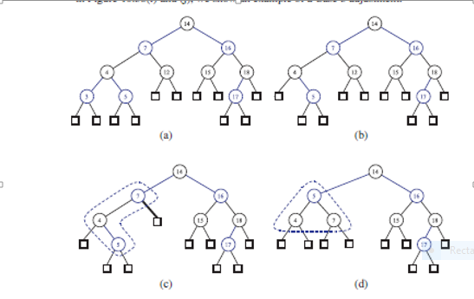
Red-Black Removal Example (1)
Figure 10.37
v is red
Remove 3
Remove 12
Case 1
Remove 17

Slide 140
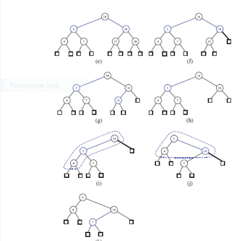
Red-Black Removal Example (2)
Remove 18
Case 2
v is red
Remove 15
Remove 16
x
Case 3
y
r
Case 2
Figure 10.38

Slide 141
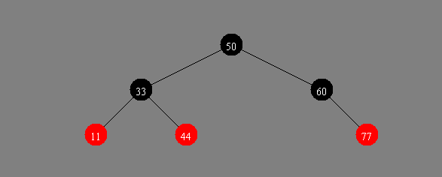
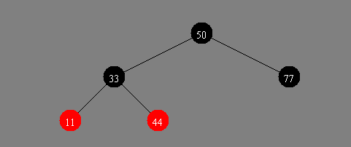
Another Red-Black Tree Remove Example (1)
v
v is black and r is red
implies a recolor
w
r
Delete 60

Slide 142
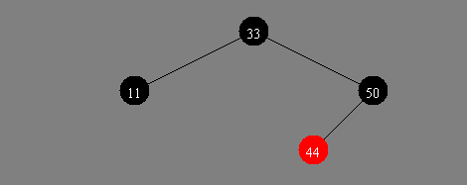
Another Red-Black Tree Remove Example (2)
x=c
y=b
v
z=a
w
r
Delete 77
b
Case 1
a
c

Slide 143
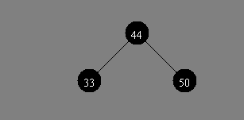
Another Red-Black Tree Remove Example (3)
x=a
v
y=c
Delete 11
w
r
z=b
b
c
a

Slide 144
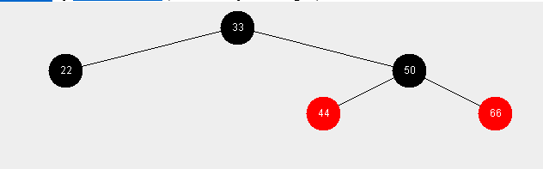
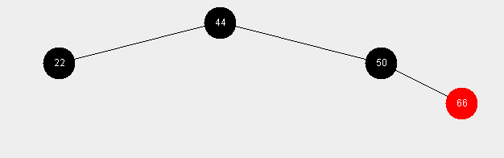
Still Another Red-Black Tree Remove Example
Delete 33
33 is replaced by 44

Slide 145
Still Another Red-Black Tree Remove Example
Delete 33
33 is replaced by 44

Slide 146
Red-Black Tree Reorganization
Insertion | remedy double red
Red-black tree action | (2,4) tree action | result
restructuring | change of 4-node representation | double red removed
recoloring | split | double red removed or propagated up

Slide 147
Red-Black Tree Reorganization
Removal | remedy double black
Red-black tree action | (2,4) tree action | result
restructuring | transfer | double black removed
recoloring | fusion | double black removed or propagated up
adjustment | change of 3-node representation | restructuring or recoloring follows

Slide 148
C++ Implementation of a Red-Black Tree
See pages 488-491
Extra credit – implement a dictionary uses a red-black tree

Slide 149
Backup

Slide 150
Amortized Analysis of Splay Trees
Running time of each operation is proportional to time for splaying
Define rank(v) as the logarithm (base 2) of the number of nodes in sub-tree rooted at v
Costs: zig = $1, zig-zig = $2, zig-zag = $2 (cyber dollars)
Thus, cost for splaying a node at depth d = $d
Imagine that we store rank(v) cyber-dollars at each node v of the splay tree (just for the sake of analysis)

Slide 151
Cost of Splaying
If the payment is equal to the splaying work, one uses it to pay for the splaying
If the payment is greater than the splaying work, one deposit the excess in the account of several nodes
If the payment is less than the splaying work, one withdrawals from the account of several nodes
Payment of O(log n) dollars is sufficient to keep the system working

Slide 152
Cost per zig
T
y
T’
zig
T₄
x
x
w
T₃
w
y
T₁
T₂
T₃
T₄
T₁
T₂
Doing a zig at x costs at most rank’(x) - rank(x):
cost = rank’(x) + rank’(y) - rank(y) - rank(x) < rank’(x) - rank(x)
Define rank(v) as the logarithm (base 2) of the number of nodes in sub-tree rooted at v

Slide 153
Cost per zig-zig and zig-zag
T
z
T’
x
T₄
zig-zig
T₁
y
y
x
T₃
T₂
z
T₁
T₂
T₃
T₄
Doing a zig-zig or zig-zag at x costs at most 3(rank’(x) - rank(x)) (2)
Define rank(v) as the logarithm (base 2) of the number of nodes in sub-tree rooted at v
T
T’
z
zig-zag
x
T₁
y
z
y
x
T₄
T₁
T₂
T₃
T₄
T₂
T₃

Slide 154

Performance of Splay Trees
Rank of a node is logarithm of its size
Thus, amortized cost of any splay operation is O(log n)
In fact, the analysis goes through for any reasonable definition of rank(x)
This implies that splay trees can actually adapt to perform searches on frequently-requested items much faster than O(log n) in some cases

